Slide 1

HR Data Analysis and Prediction

Slide 2
Introduction:
HR analytics is revolutionizing the way human resources departments operate, leading to higher efficiency and better results overall. Human resources has been using analytics for years. However, the collection, processing and analysis of data has been largely manual, and given the nature of human resources dynamics and HR KPIs, the approach has been constraining HR. Therefore, it is surprising that HR departments woke up to the utility of machine learning so late in the game. Here is an opportunity to try predictive analytics in identifying the employees most likely to get promoted.

Slide 3
Business Problem:
One of the problem a large MNC is facing is around identifying the right people for promotion (only for manager position and below) and prepare them in time. Currently the process, they are following is:
Identifying a set of employees based on recommendations/ past performance.
Selected employees go through a separate training and evaluation program.
At the end of the program, based on various factors such as training performance, KPI completion (only employees with KPIs completed greater than 60% are considered) etc., employee gets promotion.
For above mentioned process, the final promotions are only announced after the evaluation, and this leads to delay in transition to their new roles. Hence, company needs help in identifying the eligible candidates at a particular checkpoint so that they can expedite the entire promotion cycle.

Slide 4
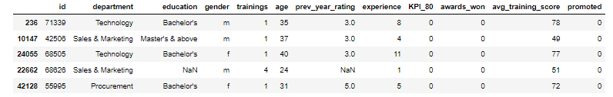
Data Assessment:

Slide 5
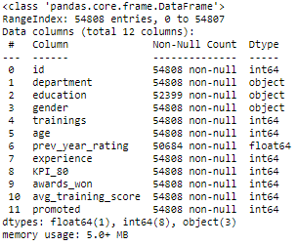
Data Types:

Slide 6
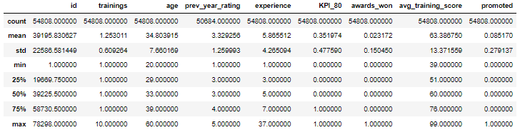
Numerical Distributions:

Slide 7
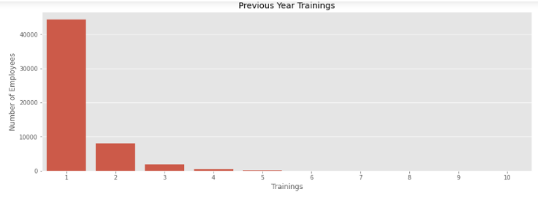
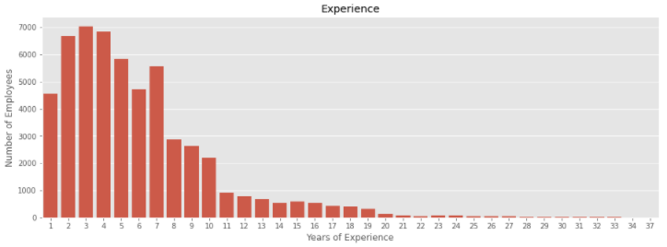
Outliers:

Slide 8
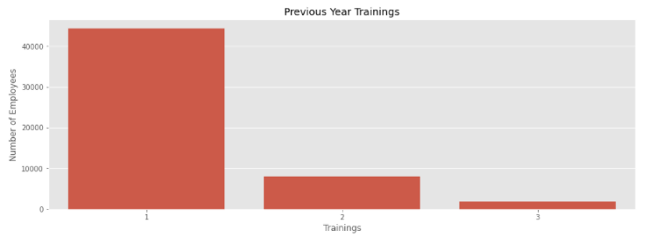
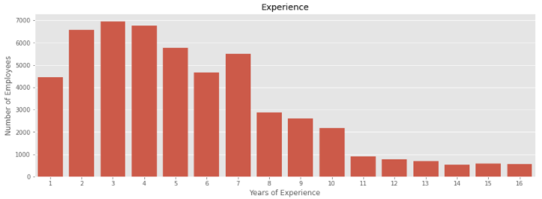
Cleaning:

Slide 9
Wrangling Summary:
After downloading the dataset and assessing it visually and programmatically we found some quality issues like:
Outliers in [‘trainings’, ‘experience’] columns.
Nulls in [‘education’, ‘prev_year_rating’] columns.
Cleaning process:
Detected and removed outliers above 0.99 quantile from trainings column.
Detected and removed outliers above 0.97 quantile from experience column.
Replaced null values from education column with the most frequent value and those from prev_year_rating with median value.

Slide 10
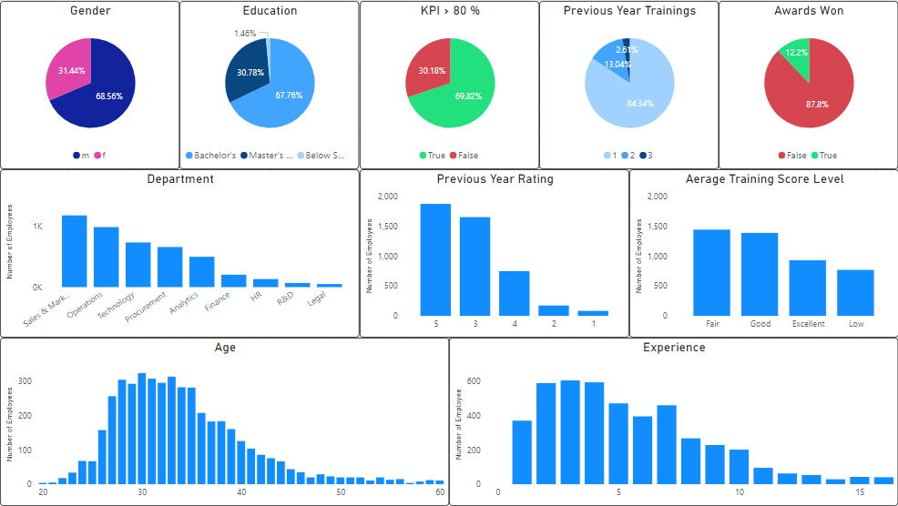
Deeper Look on Promoted Employees:

Slide 11
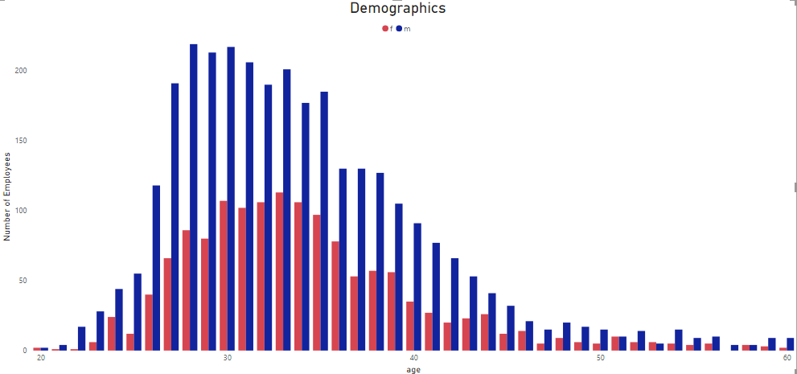
Demographics:

Slide 12
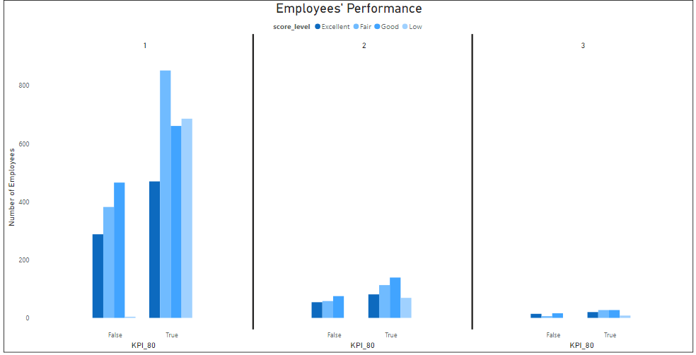
Promoted Employees’ Performance:

Slide 13
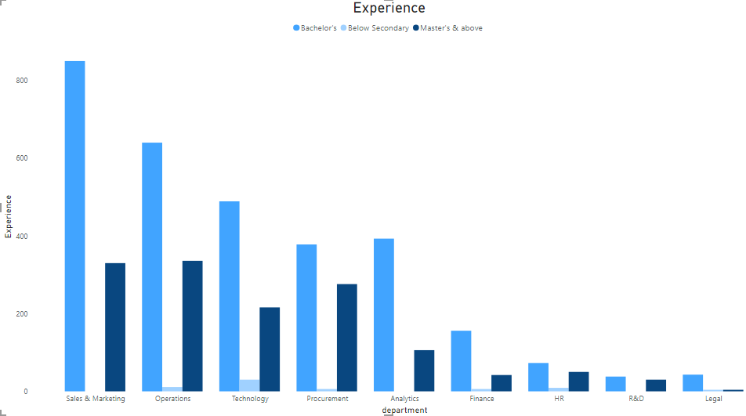
Experiences:

